Slide 1

Student Performance Summary & Review
By Michael Adesuyi
https://www.linkedin.com/in/michael-adesuyi-427861259/

Slide 2

Purpose
This data was collected to check the performance of each student based on a dataset containing math, reading, and writing scores along with demographic and socio-economic factors.
The purpose is to uncover how variables such as gender, parental education level, lunch type, and test preparation course affect student outcomes.

Slide 3
Key Objectives
Identify
Identify performance trends across different student groups.
Assess
Assess the impact of external factors (e.g., lunch program, test prep) on academic scores.
Categorise
Categorise students into performance bands (Excellent, Good, Average, Poor) based on average scores.
Provide
Provide insights that could inform targeted academic support.

Slide 4
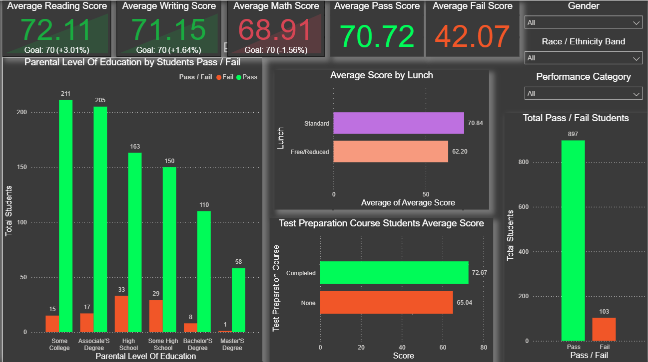
Dashboard

Slide 5

Summary
Out of 1000 students, 897 passed, while 103 failed (pass threshold = 50).
Average scores:
Math: 68.91 (just below the target of 70)
Reading: 72.11
Writing: 71.15
Test Preparation Course
Students who completed a test prep course averaged 72.67, compared to 65.04 for those who did not.
Prep completion correlates with better performance.
Lunch Type
Students with standard lunch averaged 70.84.
Those on free/reduced lunch scored 8.64 points lower, suggesting a link to economic disadvantage.
Parental Education
Students whose parents had a master’s degree had the fewest failures.
Most failures came from students whose parents had only a high school or some high school education.
Gender Differences
Females outperformed males in reading and writing.
Males slightly outperformed females in math.
Females fail rate: 7.5%, Male fail rate: 13.3%.
Race/Ethnicity Group Performance
Group E performed the best in all subjects.
Group A consistently scored the lowest across all subjects.
Performance Categories
Excellent: Avg. score ~94.4
Good: Avg. score ~81.1
Average: Avg. score ~63.6
Poor: Avg. score ~42.1

Slide 6

Recommendations
Expand Test Preparation Access
Make test prep courses mandatory.
Provide online/self-paced options for students with limited resources.
Support Economically Disadvantaged Students
Introduce after-school tutoring or study groups for students on free/reduced lunch.
Parental Engagement Programs
•Educate parents, especially those without higher education, on how to support learning at home.
Host parent-student workshops focused on study habits, literacy, and math support.
Targeted Subject Support
Math is the weakest subject overall; launch math booster programs for struggling students.
Use diagnostic assessments to personalise learning paths.
Focus on Group A & C
Prioritise intervention programs in Group A and Group C.
Assign mentors, peer support, or extra academic coaching.
Gender-Specific Support
Create writing and reading interventions tailored for male students.
Offer math confidence workshops, especially targeted at female students, to boost performance.

